Slide 1


AWS Elastic Computing assisting Humanitarian Action
Phil Cooper – Sterling Geo
Stephen Mather – Cleveland MetroParks

Slide 2

Notes:
This is a talk about paradigm change and how a trip to Dar Es Salaam in November 2016 has set up change of events leading to how we use elastic computing approaching the collection, management and exploitation of UAV imagery for the Humanitarian sector.
Maps – This is ultimately about the value of Maps.
Drones
Mapping- The recognition of the value of maps – in this example it is for humanitarian services and support and how technology can be used to improve the situation and deliver an outcome tha is understood.
Software
Image processing

Slide 3
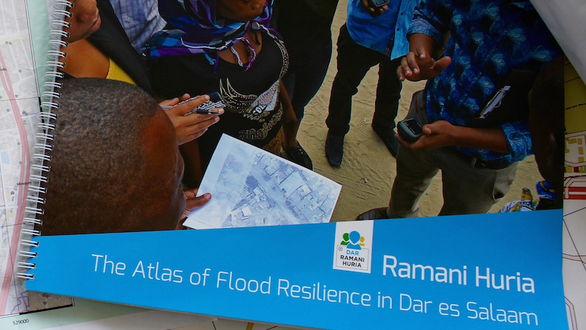
Notes:
For geographers, cartography is their trusted ally in achieving genius. Its power to combine multiple datasets, extract complex information and bring together in an elegant display makes the map the geographer’s purist visualisation tool. One which we can and must continue to embrace as the world of data grows and is constantly changing it has never been more important to create clear and easily recognizable maps.

Slide 4
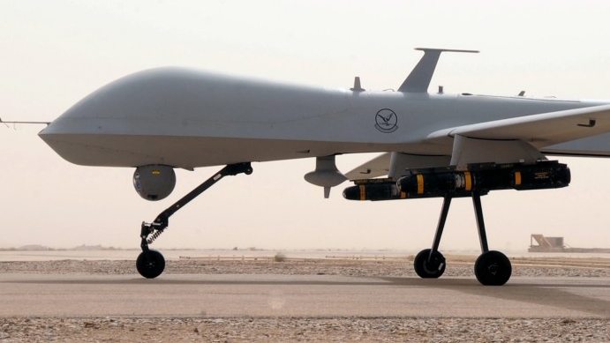
The Old Paradigm of Drones
The Image of drones was bad ! But this just isn’t the reality now
Notes:
To create these we have the new technologies and a shift in technology in hardware ( use) , which can be matched in software and processing

Slide 5
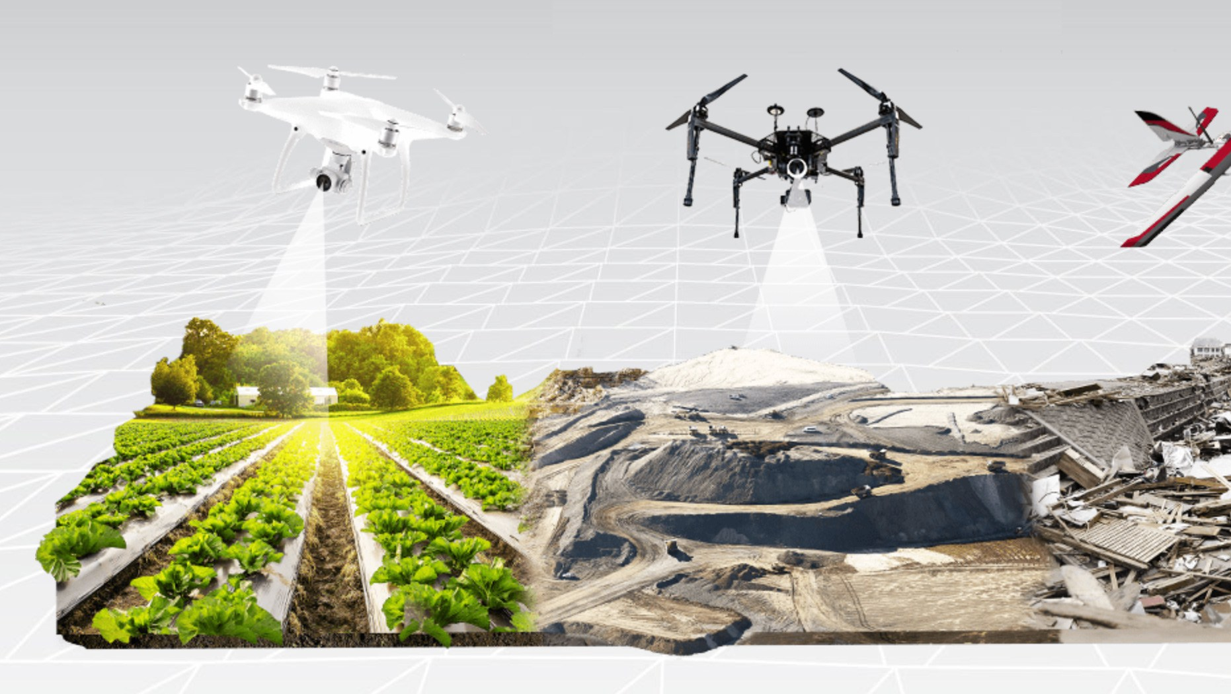
The New Paradigm of Drones /UAVs/ UAS

Slide 6
The Old Paradigm of software and processing

Slide 7
The New Paradigm of software and processing

Slide 8


The challenge in Dar Es Salaam and Zanzibar, Tanzania
300,000+ UAV images
Use of UAV for survey and imagery is seen as both cost effective, and engaging with the community
How to upload , process, and output TB’s of high resolution imagery

Slide 9
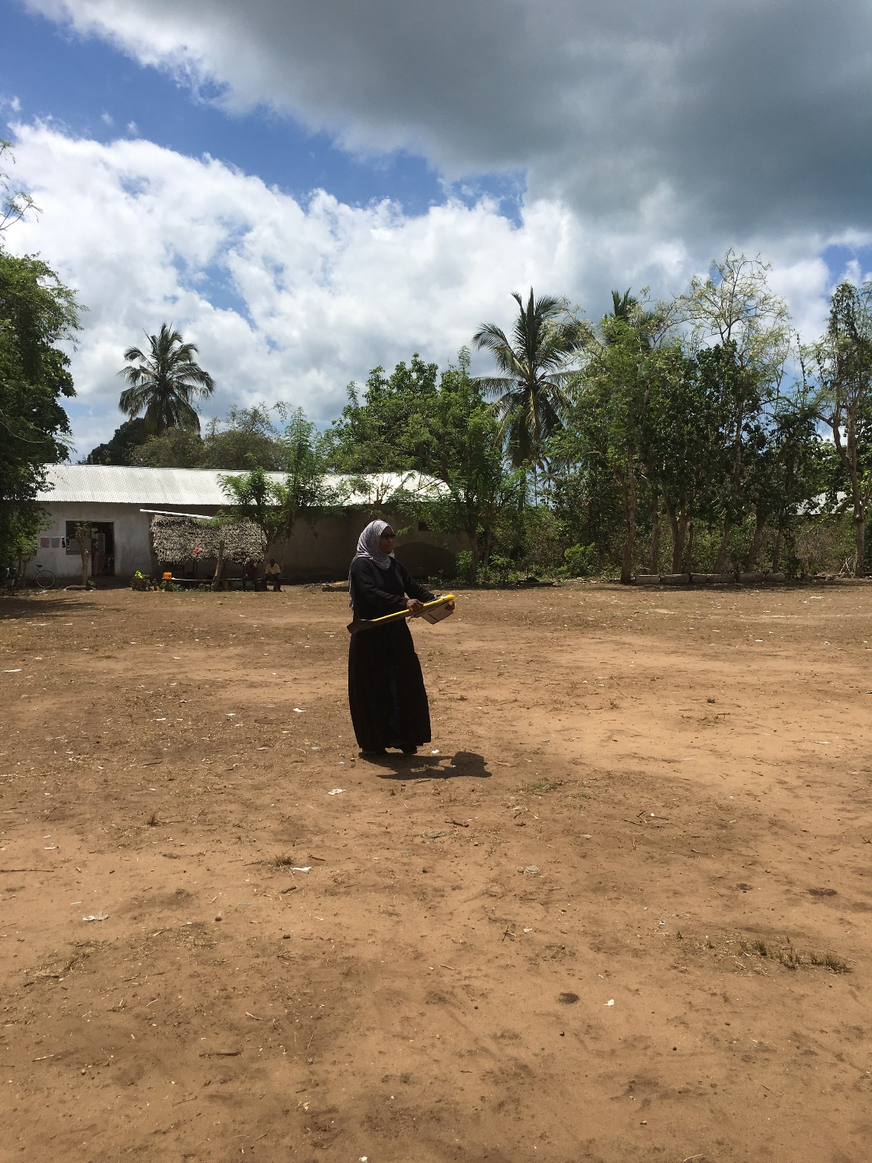
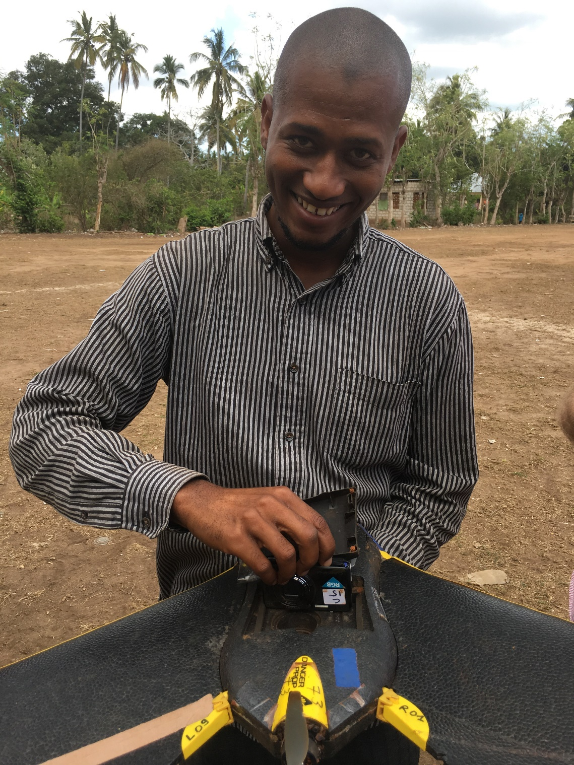

Slide 10
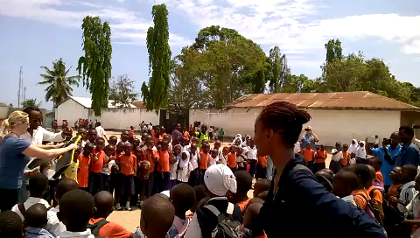
Witnessing the challenge 1st hand

Slide 11
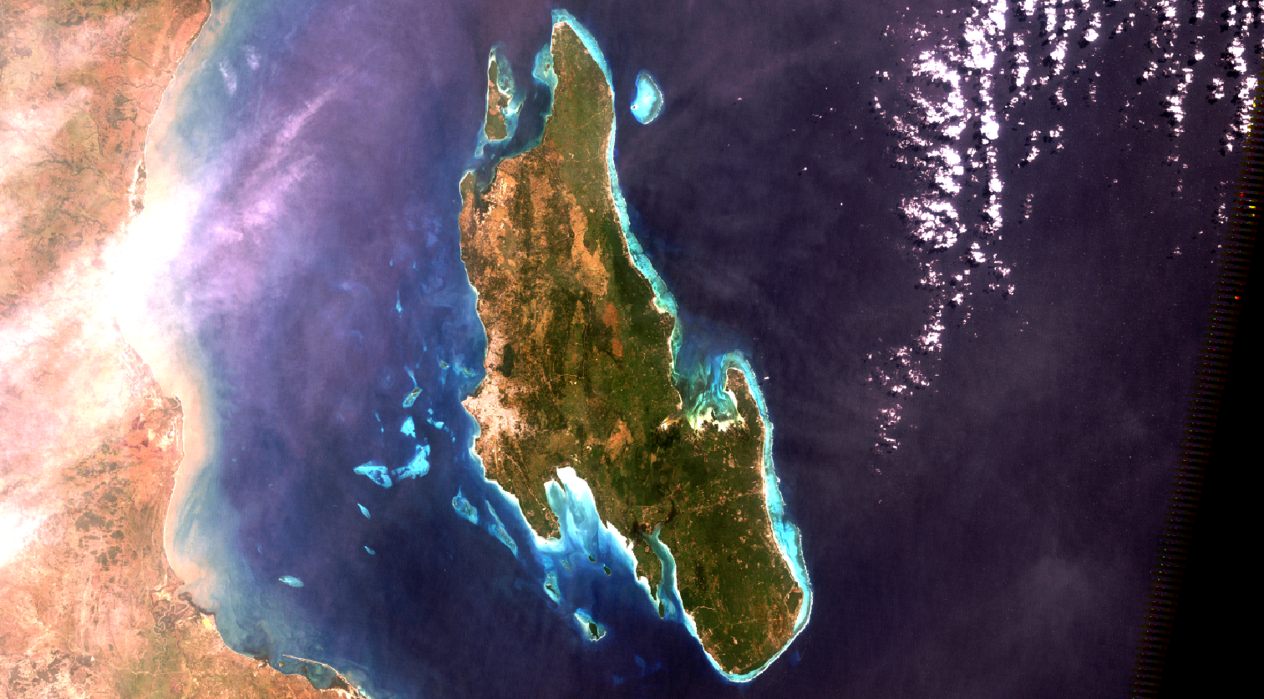

Slide 12
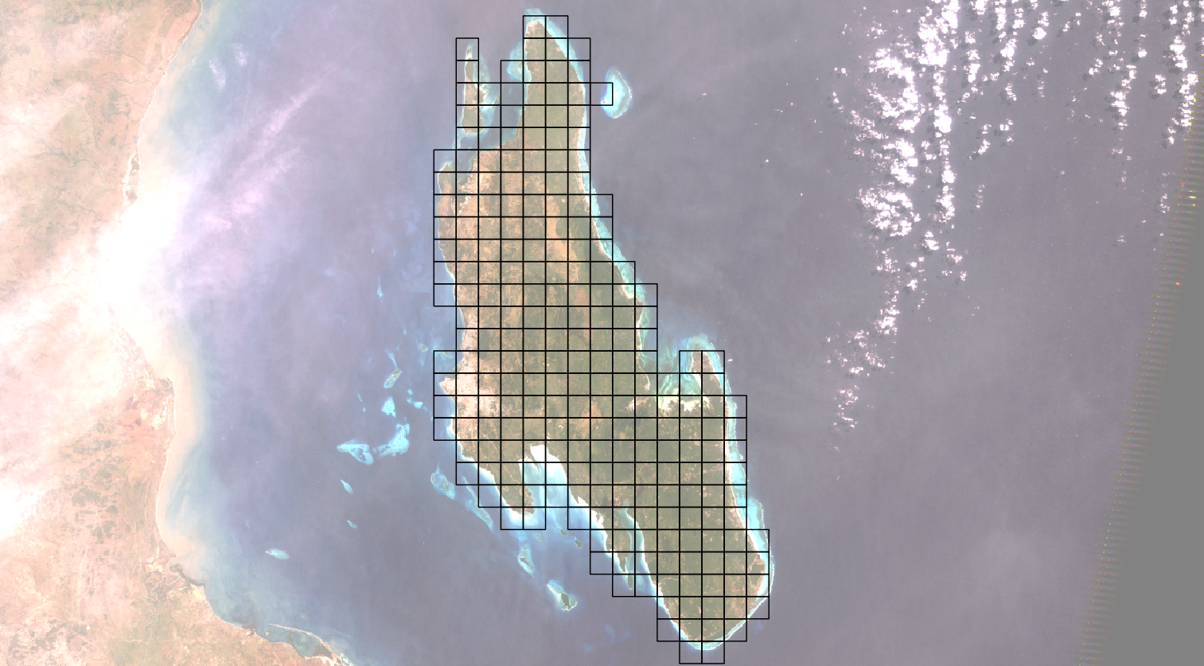

Slide 13


Formulating a solution

Slide 14
Formulating a solution

Slide 15
Origins
Computer Vision
Photogrammetry
Notes:
Ortho imagery, DTM, DSM, 3D, Volumes etc etc etc what is UAV imagery good for
A Photgrammerty 101 from Steve and where computers fit in
The belief that data and UAV imagery for Humanitarian and Ecological purposes should be available – The federation of datasets now

Slide 16

Purposes
Ecology
Humanitarian
Participatory creation of data for the public good
Support of OpenAerialDroneMap
http://image0-rubylane.s3.amazonaws.com/shops/suzanstreasures/VCx20-x201402.1L.jpg
Notes:
The benefits of UAV and photogrammetry in Ecology and Hum

Slide 17
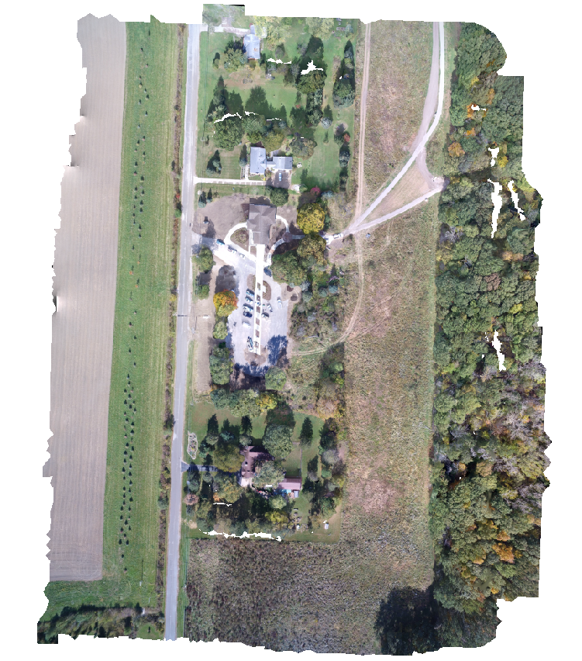
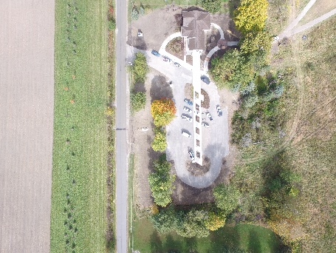
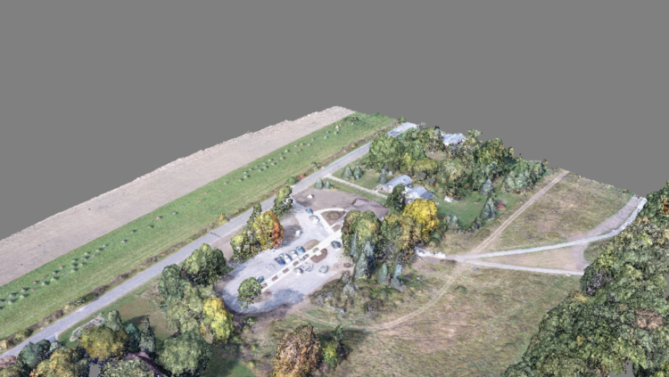
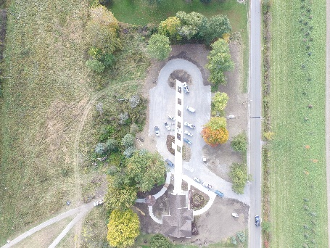
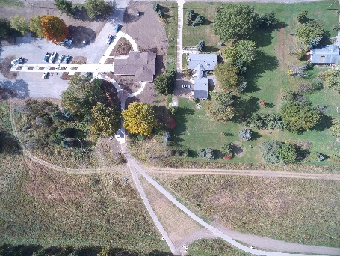
Photogrammetric Process
Notes:
Steve on photogrammetry

Slide 18
Usage
Command line tool
Portable OpenStreetMap (POSM)
Node-OpenDroneMap
Web API for ODM
WebODM
Multi-user (Django) environment for ODM
OpenDroneMap-ecs
Notes:
Steve on photogrammetry and some of the nity gritty of what has been going on

Slide 19

Future of photogrammetry processing
Quality reporting and robustness improvements
Scalability improvements
Performance improvements
http://davemilburn.deviantart.com/art/BB8-586862785
Notes:
Steve on photogrammetry futures

Slide 20

Scalability
Split large numbers of images into smaller groups
Run OpenSfM reconstruction on each subgroup
Align and transform those groups to each other using matching features between the groups
Notes:
Steve on photogramm and phil on scaling

Slide 21
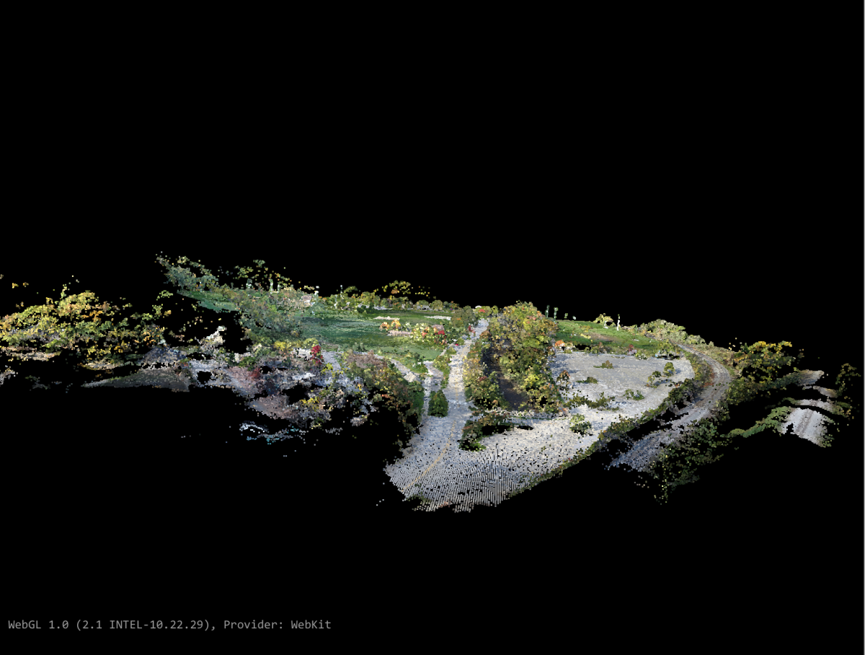
Scalability with consistency

Slide 22
Compounding Z error across large landscape
Notes:
Data qualiity is criitcal

Slide 23
Corrected Z error across large landscape
Notes:
This is al about data quality

Slide 24

Performance improvements
Improve processor use
Cascade Hashing¹ matching
or
Bag of Words²
Improved Memory Use:
Improved correspondence graph data structures
SLAM-like pose-graph methods for global adjustment of camera position
[1] Jian Cheng, Cong Leng, Jiaxiang Wu, Hainan Cui, Hanqing Lu; The IEEE Conference on Computer Vision and Pattern Recognition (CVPR), 2014, pp. 1-8
[2] Michal Havlena, Konrad Schindler; VocMatch: Efficient Multiview Correspondence for Structure from Motion; Institute of Geodesy and Photogrammetry, ETH Zurich, Switzerland

Slide 25
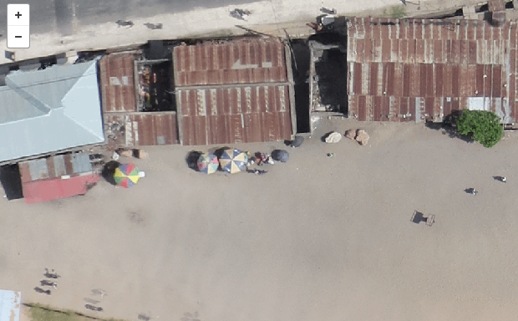
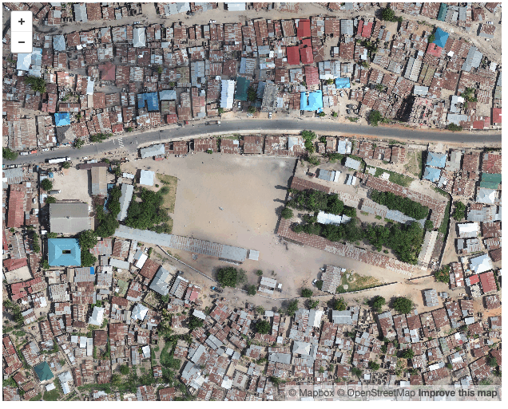
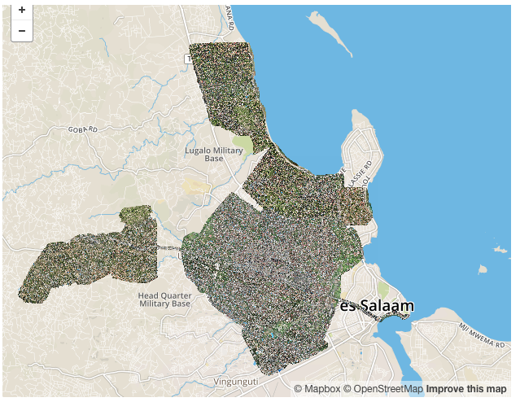
Sharing imagery using Web Services
Notes:
Getting the data out and shown ( we are talking about TB’s of imagery)

Slide 27

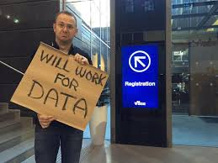


Supporting cast
Jed Sundwall Head of Open Data AWS
Brendan Bouffler
Supercomputer Man
Wil Mayers
CTO Alces
Another SuperComputer Guy

Slide 28

Going forward
But why bother?
Its all totally worthless !
We are simply crunching more big data , what’s the purpose and where are we going!

Slide 29
The new paradigm is…
Business Analytics powered by Geospatial data and Remote Sensing data
Clear drains = no flooding = no cholera = safe population

